Slide 1
12 Steps to Successfully Managing Your Rental Home
Mike Connolly
06/01/2019

Slide 2
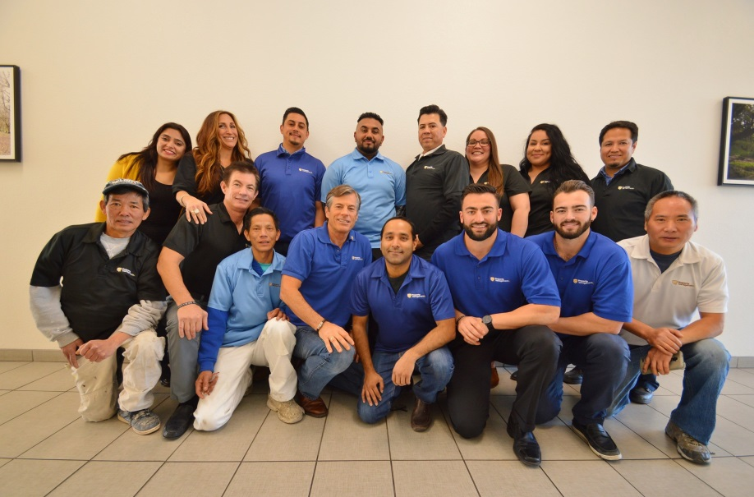
Who am I?
Owner of East Bay Property Management
We manage 400 Tri-City Properties
U.C. Berkeley Grad 1982
Property Management since 1982
Grew up in Fremont
Licensed Broker
Licensed Appraiser
Licensed Pastor
Fellow Landlord

Slide 3
Who are You?
You are one of 18,000 East Bay Landlords who own a rental home(s)
About 95% of you own 1 rental property
5% own 2 or more rental properties
You have received little if any training on managing a rental
You are an investor

Slide 4
Should you stay put or cash out?
Summarized from Bruce Norris’ “On Borrowed Time” conference in January 2019
Lending is tight
Low equity extraction
Fixed loans at 4.5% - 5%
High % of cash purchases
No construction boom
No crazy loans
Foreclosures at an all time low
All adds up to no crash… but a minor pullback in 2019.
Strategy:
Prepare for an extended flat period… 5 – 10 years
Know your property’s cap rate
If you are going to buy or exchange, make sure the home wins the tie breaker
40 year California Real Estate Investor
2000 Transactions
Called both the 1989 and 2007 crash, along with the 2012 – present recovery.
Wonderful trainer and mentor to investors
Detailed analysis using charts and graphics

Slide 5
Step 1:Present a property that is at least slightly above average

Slide 6
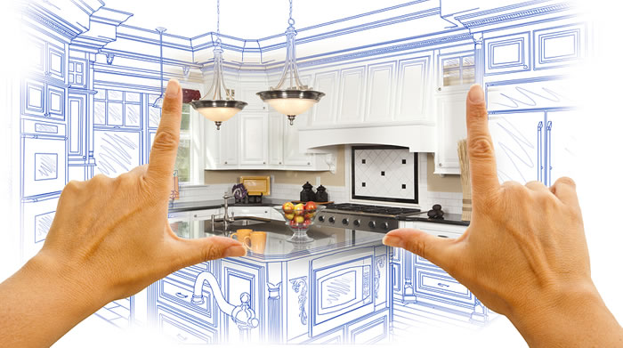
Presentation begins with rehab
Rehab matters
1) Paint
2) Flooring
3) Lights
4) Kitchen Counters
5) Kitchen Cabinets
6) Kitchen Appliances
7) Bathroom Vanity
8) Shower/Tub
9) Bath & Kitchen Fixtures
10) Yards/Landscaping

Slide 7
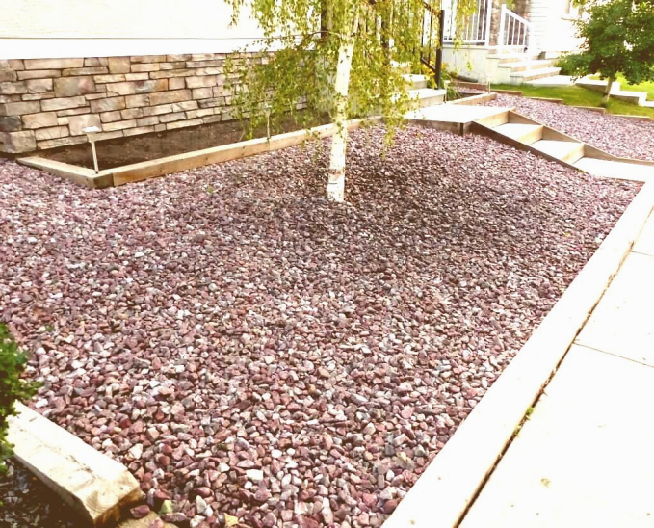
Low irrigation yards

Slide 8
Three Reasons Why Rehab Matters
For $1 invested in rehab, You’ll get back $1.50 - $2 in increased rents
I.E. A $20,000 rehab (new laminate, new paint, new windows, baseboards, blinds, vanity appliances) can equate to $350 more per month in rent = $4,200 more per year
You will add value back to your property
You will attract a higher quality tenant
“A great home attracts a great tenant”

Slide 9
Adding back value with rehab
Project Type | Job Cost | Resale Value | Cost Recouped |  | Job Cost | Resale Value | Cost Recouped
Bathroom remodel | $24,201 | $29,667 | 122% |  | $19,134 | $13,422 | 70%
Kitchen remodel | $26,145 | $38,679 | 148% |  | $21,198 | $17,193 | 81%
Dual pane windows | $17,541 | $20,205 | 115% |  | $15,955 | $11,855 | 74%
Source is Hanley Wood Media
Publishers of Custom home, builder and re-modeling magazine

Slide 10
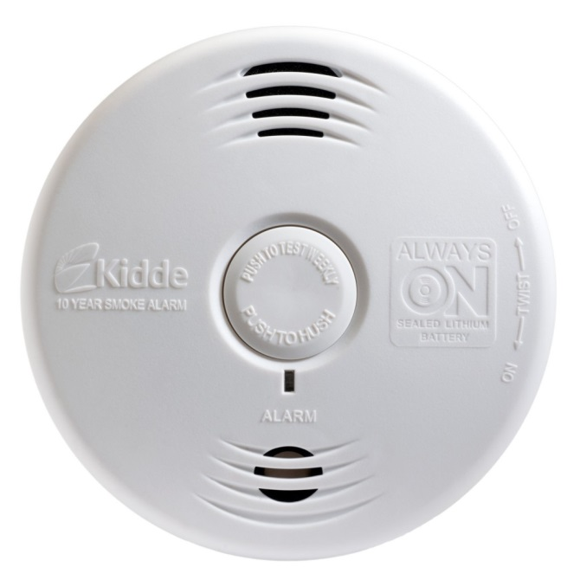
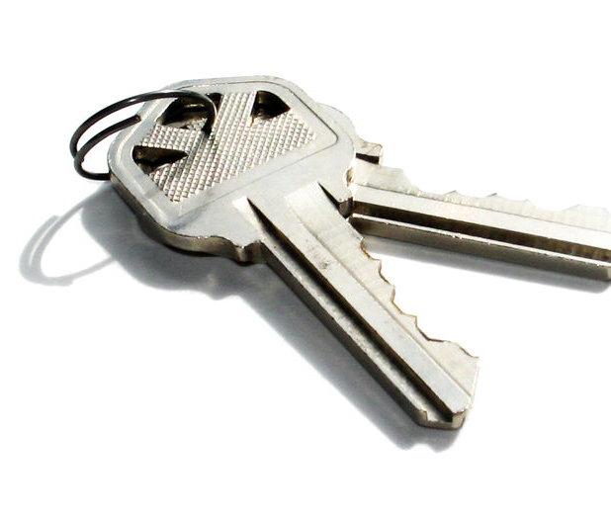
Presentation = Pre-Move in Checklist
32 item checklist
Including: Re-keying of locks, checking all appliances, spotless toilets, all lightbulbs changed, etc.
Check box and we will email you ours.

Slide 11
Step 2: Promote it well
Professional photographs
(CirclePix 877-390-6630)
Strategic ad
All 25 real estate websites (Zillow, Trulia, Hotpads)
Video tour on YouTube
“Potential Tenant” database
Yard sign
Referral fee to existing tenant

Slide 12
Step 3: Price strategically
Start with rental analysis
Base you price based on “actual” not “asking” rent of comps on Zillow (7 – 10% less)
Adjust price based on your home’s condition & amenities
Adjust price based on the season
Last two digits should be $90
Price it 3% below fair market rent ($100)
Adjust price down $50 - $100 every 10 days

Slide 13
Your rental price has nothing to do with:
Your mortgage
Your expenses
The appreciation of your home
What you hear from a friend or neighbor
It has everything to do with multiple comps of actual leases

Slide 14
Step 4: Pet Negotiable 6 Reasons why:
1. Greater pool of applicants
2. More profit
3. Longer tenancy
4. Small pet (20 pounds or less)
5. Includes a Pet Agreement:
- Number (1) - Breed
- Behavior - Size (Under 20 lbs)
- Age (no puppies) - Shots
6. Happier Tenant

Slide 15
Step 5: Picky (screen, screen, screen)
Credit score (680 or higher)
Income
Criminal background
Rental history
Number of people
Intended length of stay
Meet face to face
Obey all fair housing

Slide 16
10 Most common lawsuits against landlords
Improper tenant screening
Improper denying of an applicant
Improper handling of service/comfort animals
Improper handling of Smoke and CO2 Alarms
Improper handling of Bedbugs
Improper handling of Mold Issues (Must include Addendum)
Improper service of a Rent Increase (Must follow RRIDRO Requirements)
Improper entry into Home
Improper Move-Out Procedure
Improper deposit return

Slide 17
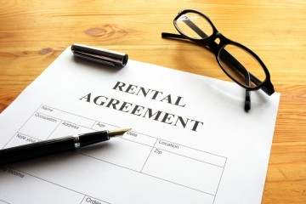
Step 6: Put it all in writing (good lease)
12 – 18 months
Landlord/Tenant responsibilities
Include gardening
Renters insurance required
Use correct addendums (mold, bedbugs, lead paint)
Damage addendum
Pet agreement
Fremont RRIDRO ordinance
Tenant Handbook
Go over lease face to face

Slide 18
Fremont’s Rental Ordinance R.R.I.D.R.O.
Residential Rental Income Dispute Resolution Ordinance
Effective 1997
These components:
One rent increase per year
Recommends 90 day notice prior to a rent increase
MUST include R.R.I.D.R.O. mediation paragraph in all leases and rent increases. If not the rent increase can be deemed invalid.

Slide 19
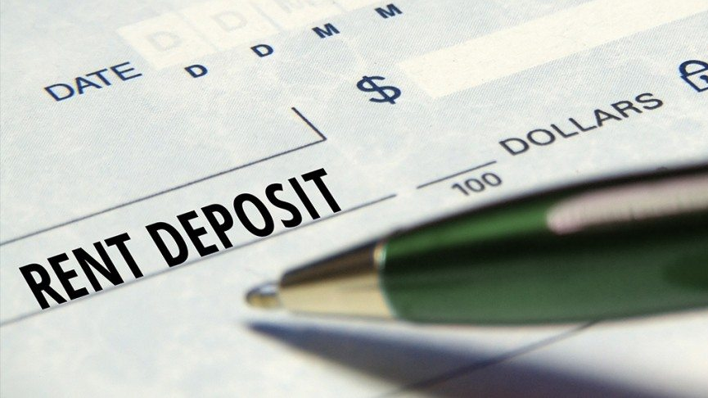
Step 7: Pay the deposit
S.F.R. and 2 – 4 units = one month’s rent
More than 5 units = half month’s rent
Credit issues = two month’s rent or more
Furnished (two month’s rent)
Pet fee is not a deposit
Get a holding fee to take the property off market (50% of rent)
Never let tenant say during their last month, “Use my deposit for my last month’s rent.”

Slide 20
Step 8: Prompt with maintenance requests
Determine responsibility (lease)
Help over the phone
Schedule vendor promptly
Vendor agreement
Never defer maintenance to Tenant
Set aside one month’s rent each year for repairs, maintenance, rehab

Slide 21
Step 9: Probe regularly (inspect)
Move-in inspection (Happy Inspector)
Annual inspection
Write inspection into lease
10 months
Detectors
Unauthorized pet
Unauthorized roommate
Furnace filter
Deferred maintenance
Move out inspection (Happy Inspector)
See EBPM Website for security deposit return

Slide 22
Step 10: Protect Yourself
Landlord Policy
Umbrella Policy (minimum $1,000,000)
Renters Insurance
Convert Ownership to an LLC

Slide 23
Advertising Violations of Fair Housing
Safe
Walk to schools
Master bedroom
Family community
Mother in law suite
Walk in closet
Near church
Private community
Exclusive
Bachelor apartment
No 60 year old males of Irish heritage
First time Fair Housing fine averages $16,000

Slide 24
Step 11: PROFIT is not a dirty word
Tax deductions
Repairs
Insurance
Management fees
Travel expenses
Utilities / H.O.A.
Depreciation
Property taxes
Mortgage interest
Landscaping/Gardening
Advertising
Legal
Home office

Slide 25
Why it might makes sense to consider selling:
Your cap rate for your East Bay home is only 2 – 2.5% while cap rates out of the Bay Area can be 6 – 7%
You sense a prolonged flat period
Geography undesirable
Owned with Siblings/Partners
No depreciation left
You want to increase the size of your rental holdings

Slide 26
How does your current rental home measure up?
No. | Asset class | Location | Current 2019 value | Monthly gross rent | Cap rate (Adjusted for property taxes) | Appreciation 2018 compared to 2017 | Risk factor 1 – 5 1 = lowest 5 = highest | Gross Rents over 10 years
1 | Single family home | East Bay | $900,00 | $3,000 | 2.2% | 3% | 1.5 | $360,000
2 | 2 Duplexes | Sacramento | $900,000 | $6,400 | 4.5% | 7% | 2.5 | $768,000
3 | Retail strip center | Fresno | $895,000 | $8,200 | 6% | 6% | 3 | $984,000
4 | 8 S.F.R. homes | Kansas City | $900,000 | $8,000 | 6% | 9% | 2.5 | $960,000
5 | 5 S.F.R. homes (new) | Central Florida | $900,000 | $8,000 | 6% | 9% | 2.5 | $960,000
6 | Four plex (8 bed 4 bath) | San Leandro | $910,000 | $6,400 | 4.5% | 3% | 2.5 | $768,000

Slide 27
Your property is the goose. What really matters are the golden eggs!

Slide 28
Landlord Real Estate
Tom Connolly
BRE 01422975
(510) 656-7653
Understands tenants
Knows rehab
1031 Expertise
Can help identify “Exchange” properties with higher cap rates
Is a landlord himself (only 5% of all realtors own rental property)
www.landlordret.com

Slide 29
Why is the 1031 so sweet?
You aren’t stuck forever with a rental property that is under-performing, difficult to manage or geographically undesirable
You can increase your portfolio’s value
You can defer taxes… (about 33%) FOREVER

Slide 30
Property Manager… makes you money
The last “P”
Professionally managed home will always make you more gross profit in the long run than managing yourself.
Optimum rent, less vacancy, best vendors, less risk
Simplify your life (70 hours per year)
Let’s meet!

Slide 31
WHO SAID MANAGING A PROPERTY MYSELF IS STRESSFUL?
I’M 38 AND I FEEL GREAT!

Slide 32
For Property Management
Call Mike Connolly (510) 996-3228
E-mail mike@eastbaypmc.com
Helpful forms and landlord videos can be found at
www.eastbaypmc.com
For real estate sales, investments, 1031 exchange,
CMA of your property
Call Tom Connolly (925) 984-1470
E-mail tcdanville@aol.com

Slide 33
Upcoming Seminars
Saturday, June 8th
10 am – 12 pm
“Should I Hold, Sell or Exchange My Rental Property In 2019”
Saturday, June 8th
1 pm – 3 pm
“Should I Hold, Sell, or Exchange My Rental Property in 2019?”
Sign up on feedback form

